Slide 1
Graphs – Searching for Relationships
COMP 200 & COMP 130
John Greiner & Stephen Wong

Slide 2
Graphs – A Reminder
Vertices/nodes + edges connecting vertices
1
2
1
2
5
5
3
4
3
4
Directed
Undirected

Slide 3
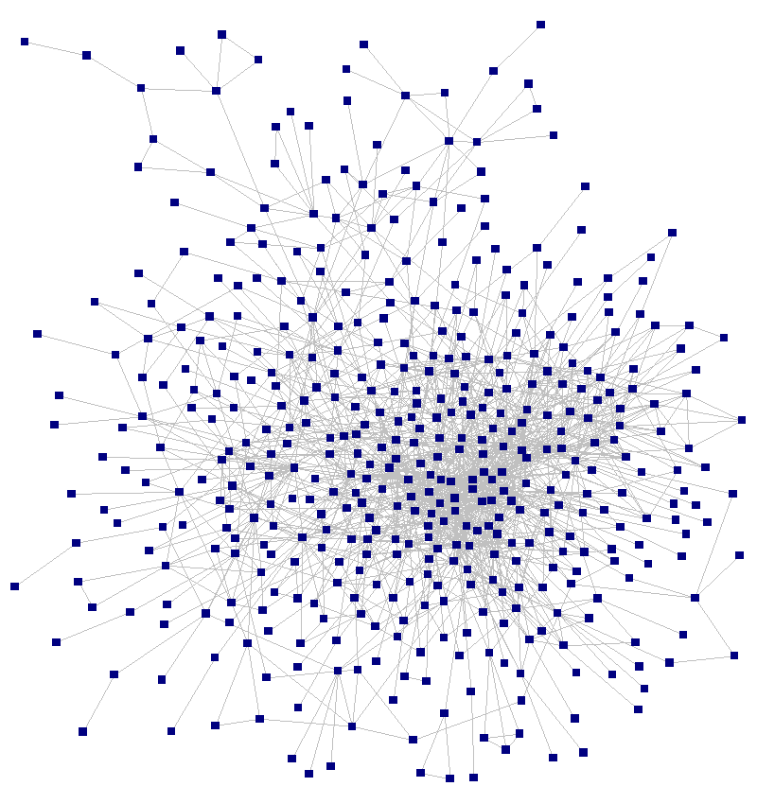


Social graph
How are you connected to someone else?
Math co-authors, centered on Paul Erdös.
Notes:
Social graph -- How

Slide 4
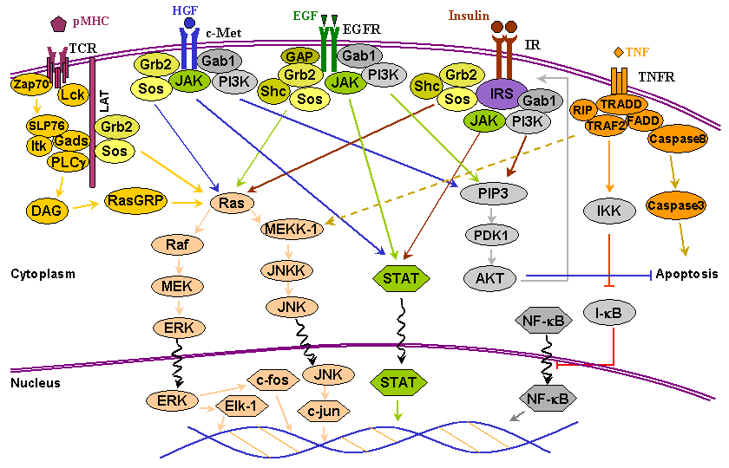
Can Introducing Hepocyte Growth Factor Lead to Apoptosis?

Slide 5
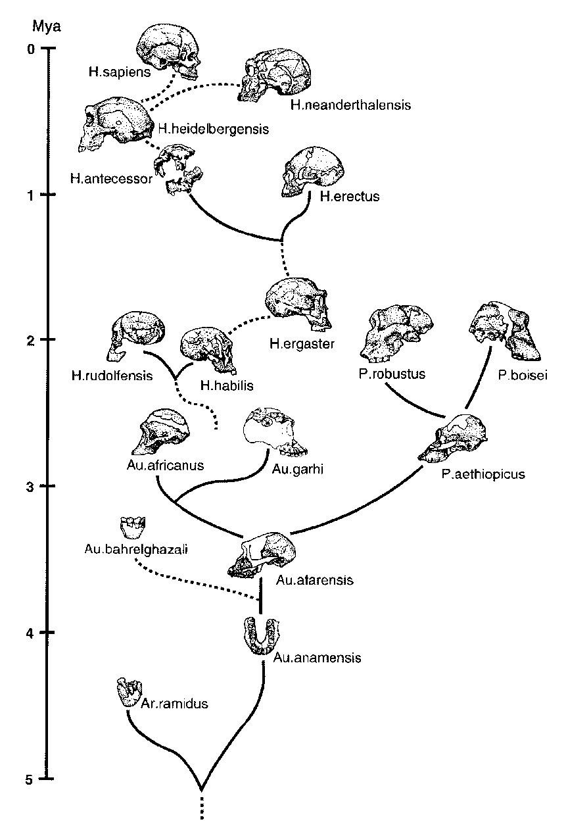
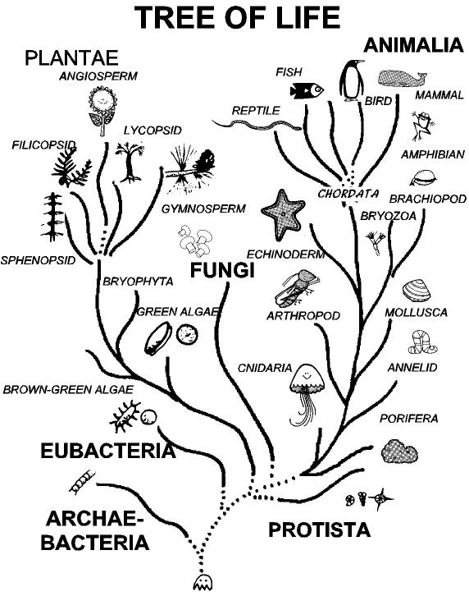
How are Two Species Related?
Notes:
Evolutionary tree, or phylogenetic tree

Slide 6
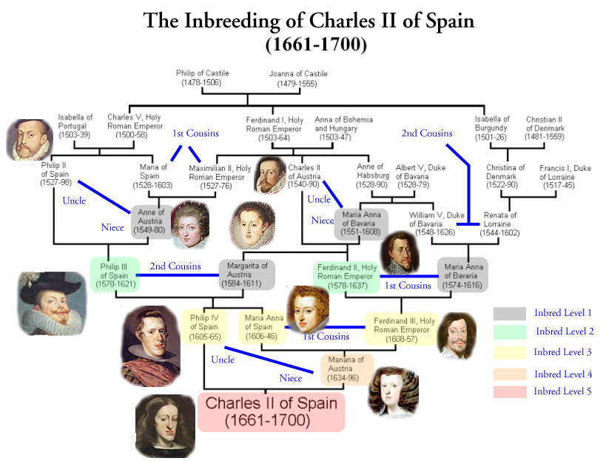
Notes:
Is one person related to another? How? Possibly multiple ways.

Slide 7


Discovering Your Own Relations

Slide 8

How to Solve a Maze?

Slide 9
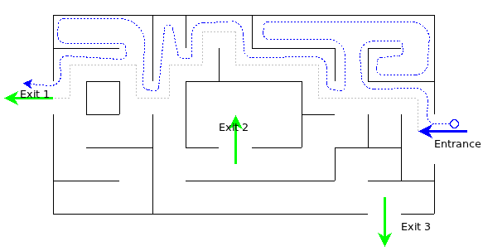
Solving a Maze: Right-Hand Rule
Good when you don’t know the maze layout.

Slide 10
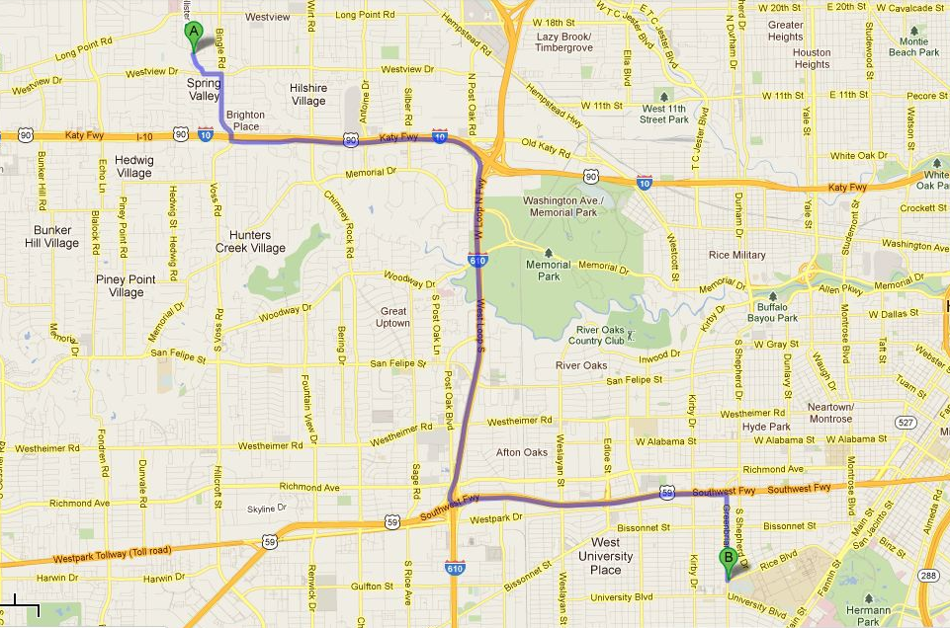
How to Get to Work?
Notes:
Finding “shortest” – here, in terms of time, not distance.
How? How would you do this, e.g., a paper map?

Slide 11
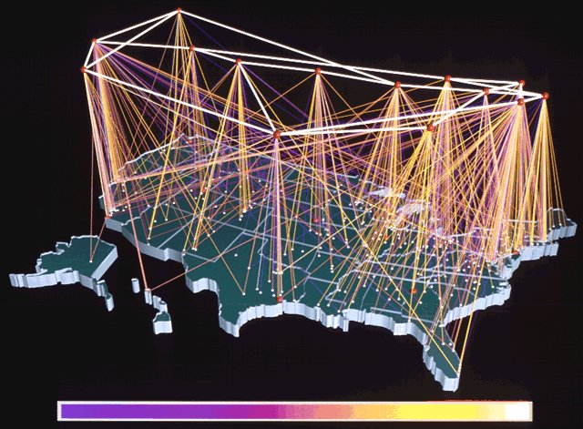
How to Route Email?
Notes:
Want to minimize transit time.
Complication: There is no global “map”, since connections change rapidly.

Slide 12
Focus on Three Algorithms
Depth-first Search
Breadth-first Search
Dijkstra’s Shortest Path
First, just quick introductions to each.

Slide 13
Depth- vs. Breadth-First Search
DFS
BFS
1
7
8
1
2c
3c
2
4
9
2b
3a
4b
3
6
5
2a
4a
3b
Notes:
Previously-shown right-hand rule is a variation on DFS.

Slide 14
Dijkstra’s Shortest Path
0
4
2
3
5
8
7
2
1
3
4

Slide 15
Dijkstra’s Shortest Path
0
4?
4
2
3
3?
5
8
7
2
1
3
7?
4
Notes:
Analogous to BFS, in that explores all edges from current frontier.

Slide 16
Dijkstra’s Shortest Path
0
4?
4
2
3
3
5
8
7
2
1
3
7?
4

Slide 17
Dijkstra’s Shortest Path
0
4?
4
2
3
3
8?
5
8
7
2
1
3
5?
4

Slide 18
Dijkstra’s Shortest Path
0
4
4
2
3
3
8?
5
8
7
2
1
3
5?
4

Slide 19
Dijkstra’s Shortest Path
0
4
6?
4
2
3
3
8?
5
8
7
2
1
3
5?
12?
4

Slide 20
Dijkstra’s Shortest Path
0
4
6?
4
2
3
3
8?
5
8
7
2
1
3
5
12?
4

Slide 21
Dijkstra’s Shortest Path
0
4
6
4
2
3
3
8?
5
8
7
2
1
3
5
12?
4

Slide 22
Dijkstra’s Shortest Path
0
4
6
4
2
3
3
8
5
8
7
2
1
3
5
12?
4

Slide 23
Dijkstra’s Shortest Path
0
4
6
4
2
3
3
8
5
8
7
2
1
3
5
9?
4

Slide 24
Dijkstra’s Shortest Path
0
4
6
4
2
3
3
8
5
8
7
2
1
3
5
9
4

Slide 25
Dijkstra’s Shortest Path
0
4
6
4
2
3
3
8
5
8
7
12?
2
1
3
5
13?
9
4

Slide 26
Dijkstra’s Shortest Path
0
4
6
4
2
3
3
8
5
8
7
12
2
1
3
5
13?
9
4

Slide 27
Dijkstra’s Shortest Path
0
4
6
4
2
3
3
8
5
8
7
12
2
1
3
5
13
9
4
Notes:
Can stop earlier if we only want shortest path to some particular node.
Is this a good algorithm for driving directions?

